Slide 1
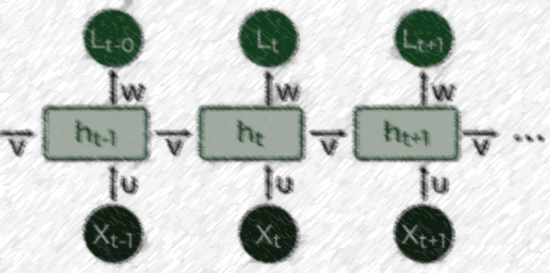

Lecture 15: RNN & LSTM
CSE445 Machine Learning
Dr. Jilan Samiuddin (JSA)
Assistant Professor
North South University

Slide 2
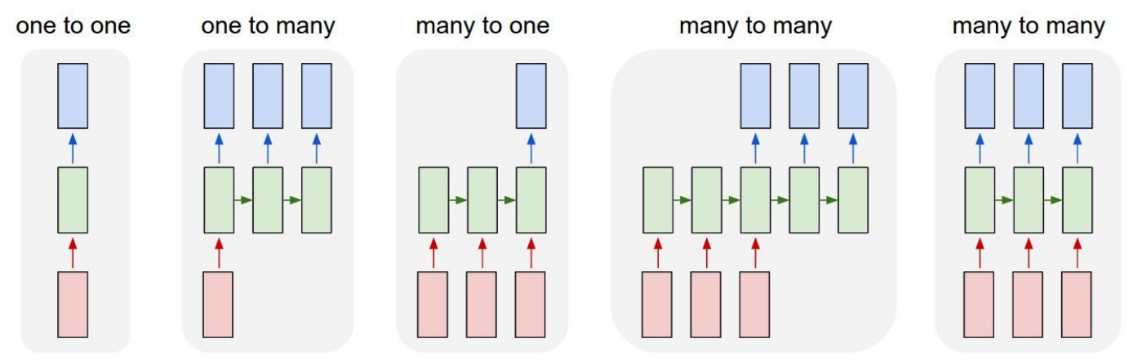
Introduction: Process Sequences
e.g. Image Captioning;
Image -> sequence of words
e.g. action prediction sequence of video frames -> action class
e.g. Video Captioning Sequence of video frames -> caption
e.g. Video classification on frame level

Slide 3
Recurrent Neural Networks (RNNs)
How RNNs Differ from Regular Neural Networks
Standard neural networks process data only forward, from input → output.
Recurrent Neural Networks (RNNs) introduce feedback connections, allowing information to cycle back into the network.
At each time step, an RNN takes current input + hidden state (memory) from the previous step.
Intuition (Example: Predicting the Next Word)
When reading a sentence, you rely on previous words to predict the next one.
RNNs mimic this behavior by “remembering” past inputs through their hidden state.
The output of one step becomes part of the input for the next step, enabling context-aware predictions.
This ability to use information from earlier steps helps RNNs understand sequence structure and context.

Slide 4
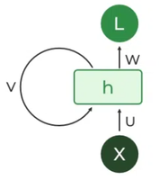
Recurrent Neurons in RNNs
The core building block of an RNN is the Recurrent Unit.
It maintains a hidden state that stores information from earlier inputs in the sequence.
By feeding this hidden state back at each time step, the unit can retain and use past information, enabling the model to capture temporal dependencies.
Image credit: GeeksForGeeks.org

Slide 5
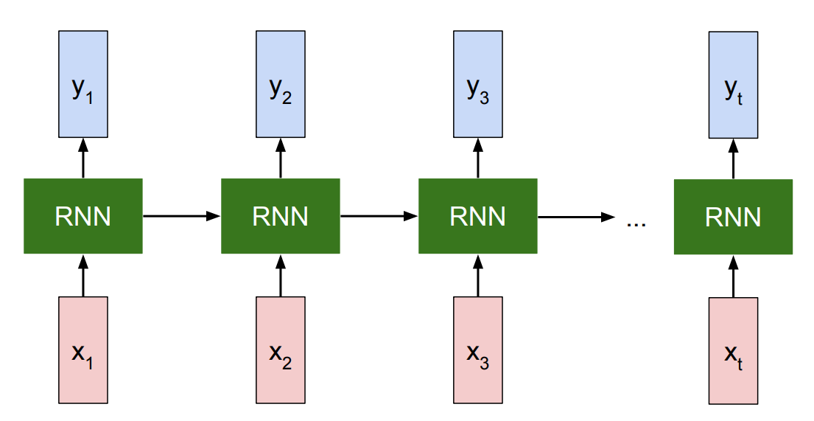
Unrolled RNN
Unfolding expands the recurrent structure across time steps, showing each step as a separate copy of the network.
This representation illustrates how information flows from one time step to the next.
Unrolling allows Backpropagation Through Time (BPTT), where errors are propagated across all time steps.
BPTT updates the weights using information from the entire sequence, helping the RNN learn temporal dependencies.
Image credit: Stanford

Slide 6
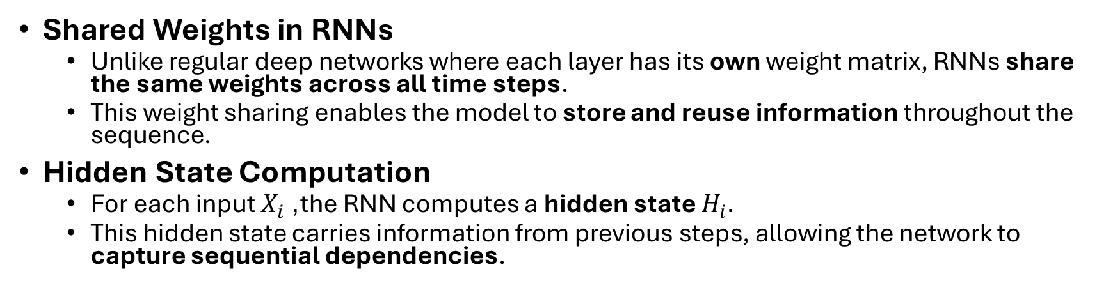
Unrolled RNN (contd.)
Shared Weights in RNNs
Unlike regular deep networks where each layer has its own weight matrix, RNNs share the same weights across all time steps.
This weight sharing enables the model to store and reuse information throughout the sequence.
Hidden State Computation
For each input $X_{i}$, the RNN computes a hidden state $H_{i}$.
This hidden state carries information from previous steps, allowing the network to capture sequential dependencies.
NOTE: All RNNs shown share the same weights.

Slide 7
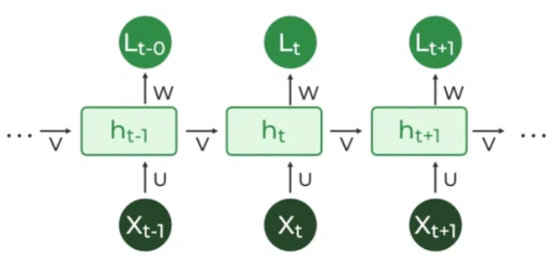
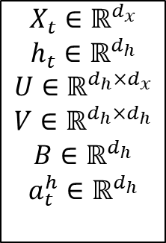
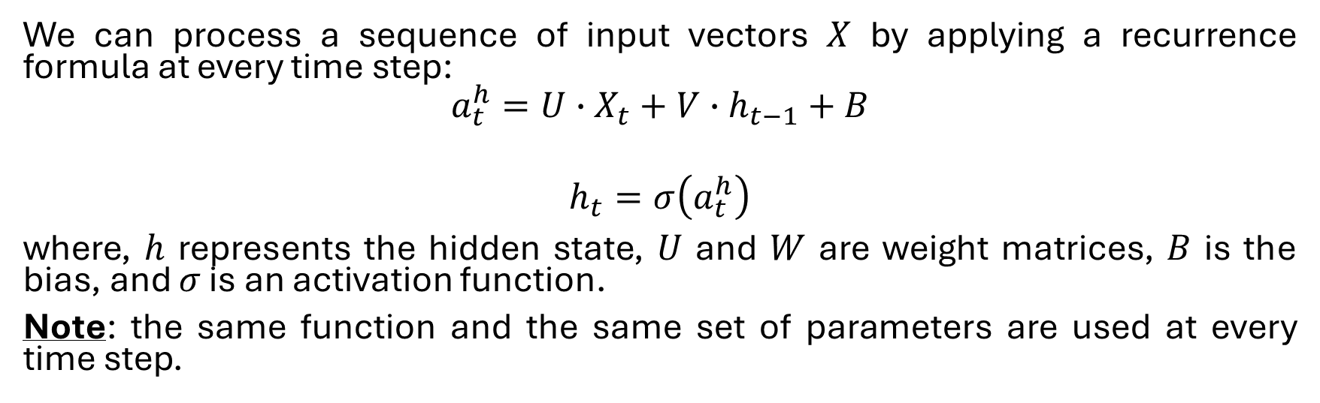
Hidden State Calculation
We can process a sequence of input vectors $X$ by applying a recurrence formula at every time step:
$$a_{t}^{h}=U∙X_{t}+V∙h_{t−1}+B$$
$$h_{t}=σ\left(a_{t}^{h}\right)$$
where, $h$ represents the hidden state, $U$ and $W$ are weight matrices, $B$ is the bias, and $σ$ is an activation function.
Note: the same function and the same set of parameters are used at every time step.
$$X_{t}∈ℝ^{d_{x}}$$
$$h_{t}∈ℝ^{d_{h}}$$
$$U∈ℝ^{d_{h}×d_{x}}$$
$$V∈ℝ^{d_{h}×d_{h}}$$
$$B∈ℝ^{d_{h}}$$
$$a_{t}^{h}∈ℝ^{d_{h}}$$
Image credit: GeeksForGeeks.org

Slide 8
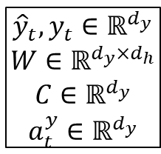
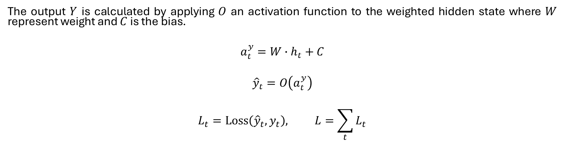
Output Calculation
The output $Y$ is calculated by applying $O$ an activation function to the weighted hidden state where $W$ represent weight and $C$ is the bias.
$$a_{t}^{y}=W∙h_{t}+C$$
$${\hat{y}}_{t}=O\left(a_{t}^{y}\right)$$
$$L_{t}=Loss\left({\hat{y}}_{t},y_{t}\right), L=\sum_{t}{L_{t}}$$
$${\hat{y}}_{t},y_{t}∈ℝ^{d_{y}}$$
$$W∈ℝ^{d_{y}×d_{h}}$$
$$C∈ℝ^{d_{y}}$$
$$a_{t}^{y}∈ℝ^{d_{y}}$$

Slide 9
Calculation Summary
Use the same computational function and parameters across different time steps of the sequence
Each time step: takes the input entry and the previous hidden state to compute the output entry
Loss: typically computed every time step

Slide 10
Training RNN
Principle: unfold the computational graph, and use backpropagation called back-propagation through time (BPTT) algorithm
Can then apply any general-purpose gradient-based techniques

Slide 11



Gradients w.r.t. $W$
$$a_{t}^{y}=W∙h_{t}+C$$
$${\hat{y}}_{t}=O\left(a_{t}^{y}\right)$$
$$L_{t}=Loss\left({\hat{y}}_{t},y_{t}\right)$$
$$L=\sum_{t}{L_{t}}$$
First
$$L←L_{t}←{\hat{y}}_{t}←a_{t}^{y}←W,C$$
Compute error at output pre-activation:
$$δ_{t}^{y}=\frac{∂L_{t}}{∂a_{t}^{y}}=\frac{∂L_{t}}{∂{\hat{y}}_{t}}∙\frac{∂{\hat{y}}_{t}}{∂a_{t}^{y}}=\frac{∂L_{t}}{∂{\hat{y}}_{t}}∙O^{′}\left(a_{t}^{y}\right)∈ℝ^{d_{y}}$$
Now,
$$\frac{∂a_{t}^{y}}{∂W}=h_{t}$$
​Hence,
$$\frac{∂L_{t}}{∂W}=\frac{∂L_{t}}{∂{\hat{y}}_{t}}∙\frac{∂{\hat{y}}_{t}}{∂a_{t}^{y}}∙\frac{∂a_{t}^{y}}{∂W}=δ_{t}^{y}h_{t}^{T}∈ℝ^{d_{y}×d_{h}}$$
Finally, gradient w.r.t $W$:
$$\frac{∂L}{∂W}=\sum_{t}{δ_{t}^{y}h_{t}^{T}}$$

Slide 12
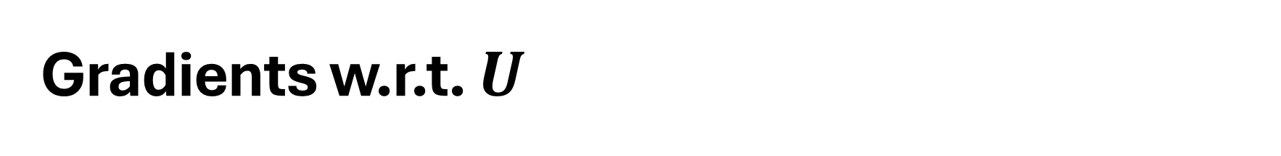


Gradients w.r.t. $U$
$$a_{t}^{h}=U∙X_{t}+V∙h_{t−1}+B$$
$$h_{t}=σ\left(a_{t}^{h}\right)$$
$$a_{t}^{y}=W∙h_{t}+C$$
$${\hat{y}}_{t}=O\left(a_{t}^{y}\right)$$
$$L_{t}=Loss\left({\hat{y}}_{t},y_{t}\right)$$
$$L=\sum_{t}{L_{t}}$$
First:
$$X_{t}→a_{t}^{h} w.r.t. U and V→h_{t}→a_{t}^{y}→{\hat{y}}_{t}→L_{t}→L$$
Then, define
$$δ_{t}^{h}=\frac{∂L_{t}}{∂a_{t}^{h}}=\frac{∂L_{t}}{∂{\hat{y}}_{t}}∙\frac{∂{\hat{y}}_{t}}{∂a_{t}^{y}}∙\frac{∂a_{t}^{y}}{∂h_{t}}∙\frac{∂h_{t}}{∂a_{t}^{h}}$$
$$\frac{∂L_{t}}{∂{\hat{y}}_{t}}∙\frac{∂{\hat{y}}_{t}}{∂a_{t}^{y}}∙\frac{∂a_{t}^{y}}{∂h_{t}}=W^{T}δ_{t}^{y}$$
$$\frac{∂L_{t}}{∂U}=\frac{∂L_{t}}{∂a_{t}^{h}}∙\frac{∂a_{t}^{h}}{∂U}=δ_{t}^{h}X_{t}^{T}∈ℝ^{d_{h}×d_{x}}$$
Finally,
$$\frac{∂L}{∂U}=\sum_{t}{δ_{t}^{h}X_{t}^{T}}$$

Slide 13
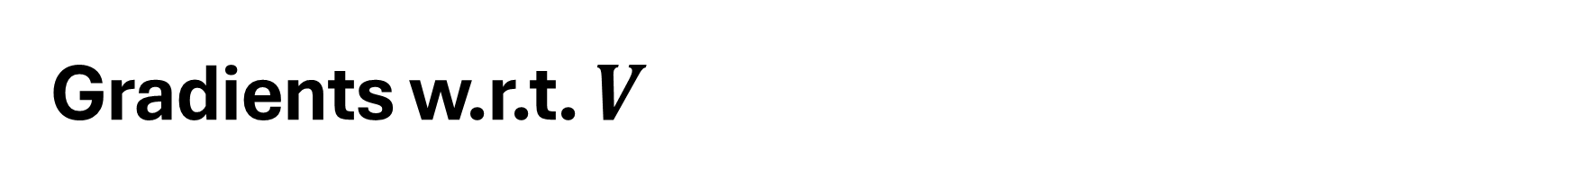

Gradients w.r.t. $V$
$$a_{t}^{h}=U∙X_{t}+V∙h_{t−1}+B$$
$$h_{t}=σ\left(a_{t}^{h}\right)$$
$$a_{t}^{y}=W∙h_{t}+C$$
$${\hat{y}}_{t}=O\left(a_{t}^{y}\right)$$
$$L_{t}=Loss\left({\hat{y}}_{t},y_{t}\right)$$
$$L=\sum_{t}{L_{t}}$$
First:
$$X_{t}→a_{t}^{h} w.r.t. U and V→h_{t}→a_{t}^{y}→{\hat{y}}_{t}→L_{t}→L$$
Then, define
$$δ_{t}^{h}=\frac{∂L_{t}}{∂a_{t}^{h}}=\frac{∂L_{t}}{∂{\hat{y}}_{t}}∙\frac{∂{\hat{y}}_{t}}{∂a_{t}^{y}}∙\frac{∂a_{t}^{y}}{∂h_{t}}∙\frac{∂h_{t}}{∂a_{t}^{h}}$$
$$\frac{∂L_{t}}{∂{\hat{y}}_{t}}∙\frac{∂{\hat{y}}_{t}}{∂a_{t}^{y}}∙\frac{∂a_{t}^{y}}{∂h_{t}}=W^{T}δ_{t}^{y}$$
$$\frac{∂L_{t}}{∂V}=\frac{∂L_{t}}{∂a_{t}^{h}}∙\frac{∂a_{t}^{h}}{∂V}=δ_{t}^{h}h_{t−1}^{T}∈ℝ^{d_{h}×d_{h}}$$
Finally,
$$\frac{∂L}{∂V}=\sum_{t}{δ_{t}^{h}h_{t−1}^{T}}$$

Slide 14
Vanishing & Exploding Gradients
During backpropagation, gradients are computed by multiplying many derivative terms across layers. These repeated multiplications can cause gradients to become very small (vanish) or very large (explode).
If these derivatives have magnitudes less than 1 → gradients shrink exponentially
If these derivatives have magnitudes more than 1 → gradients grow exponentially
Deep networks have long chains → stronger effect
Vanishing Gradients
Gradients become near zero in early layers
Earlier layers learn very slowly or not at all
Exploding Gradients
Gradients become very large
Leads to unstable training, weight blow-up, and divergence
Impact
Difficult optimization
Poor convergence

Slide 15
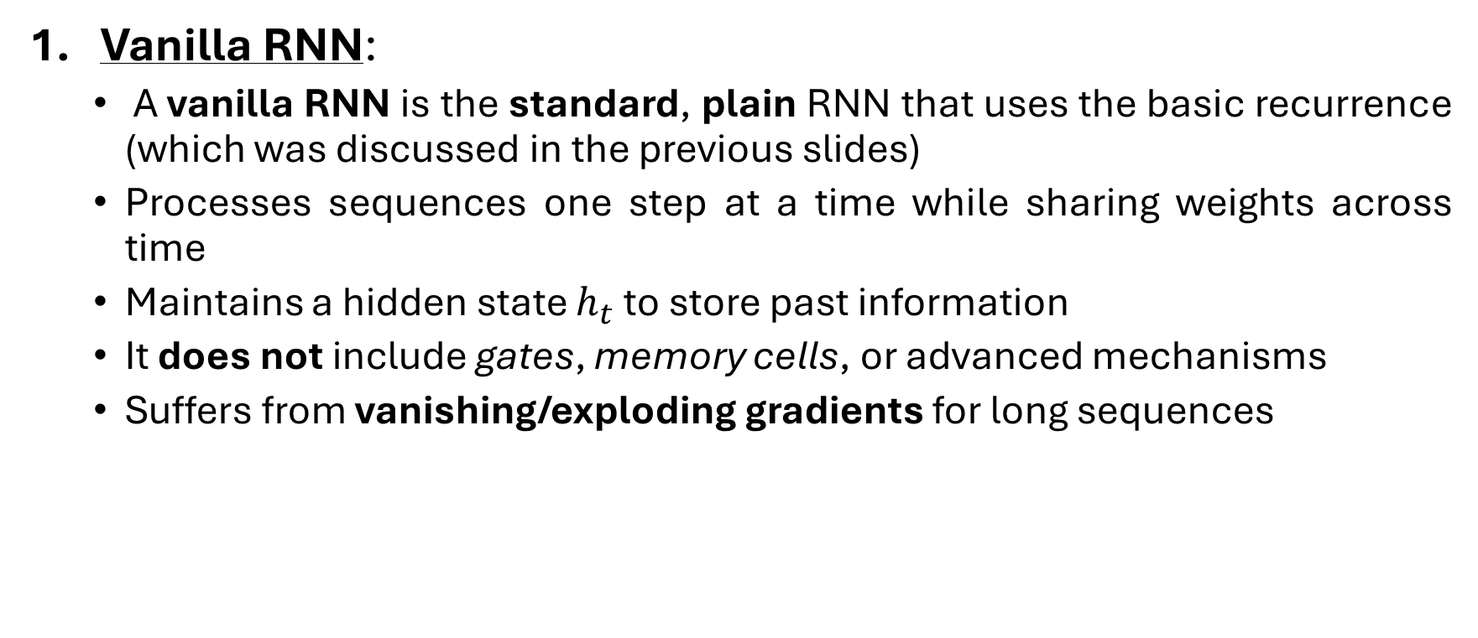
Variants of RNN
Vanilla RNN:
A vanilla RNN is the standard, plain RNN that uses the basic recurrence (which was discussed in the previous slides)
Processes sequences one step at a time while sharing weights across time
Maintains a hidden state $h_{t}$ to store past information
It does not include gates, memory cells, or advanced mechanisms
Suffers from vanishing/exploding gradients for long sequences

Slide 16
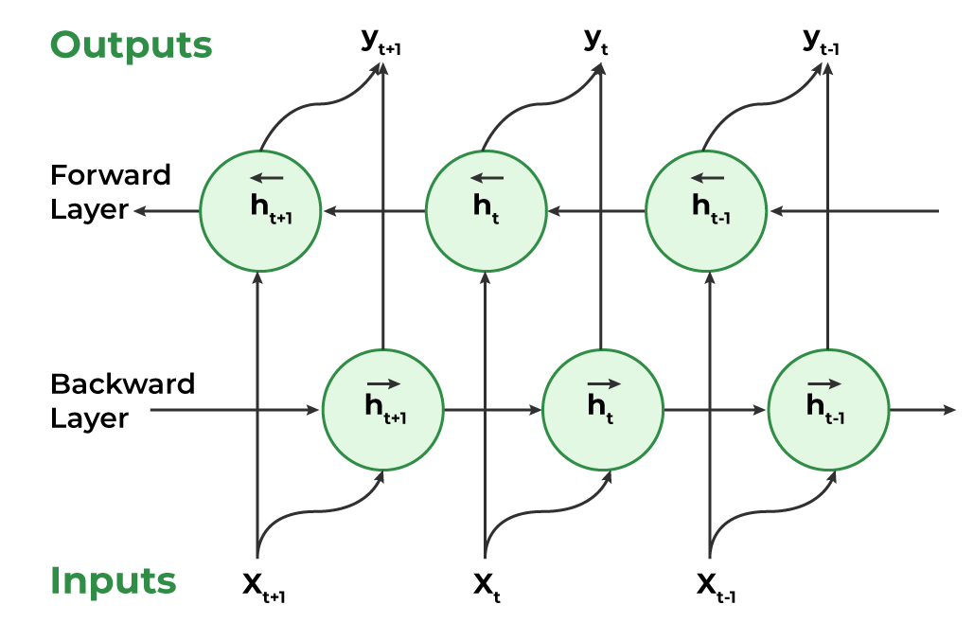
Variants of RNN (contd.)
Bidirectional Recurrent Neural Networks (BRNNs):
A BRNN processes a sequence in both directions
The final representation at each time step combines past and future context
Imagine reading a sentence where a word’s meaning depends on both previous and upcoming words.
Example: “They went to the bank to fish.”
The word bank becomes clear only when you see what comes after it.
Image credit: GeeksForGeeks.org

Slide 17
Variants of RNN (contd.)
Long Short-Term Memory Networks (LSTMs):
LSTMs introduce a dedicated memory cell that helps mitigate the vanishing gradient problem
Each LSTM cell uses three gating units to control information flow:
Input Gate: Determines how much new information is written into the cell state
Forget Gate: Selectively removes information no longer needed from the past
Output Gate: Decides what part of the cell state is exposed as the current output
This controlled memory system allows LSTMs to retain important information over long sequences, making them effective for tasks requiring long-range context

Slide 18
Long Short-Term Memory Network (LSTM)

Slide 19
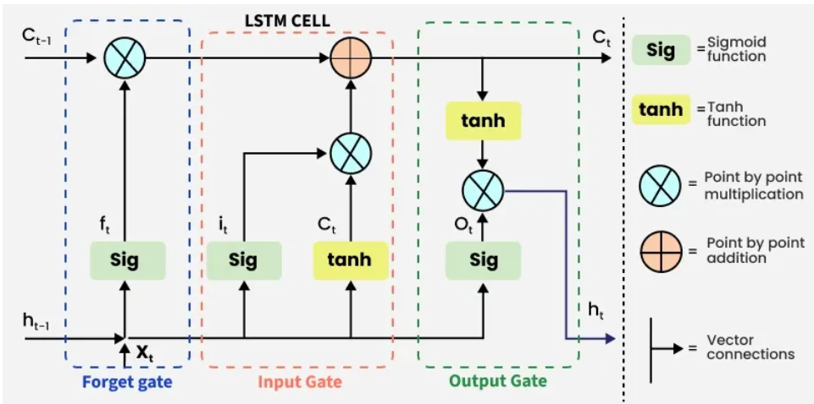
Architecture
Image credit: GeeksForGeeks.org

Slide 20
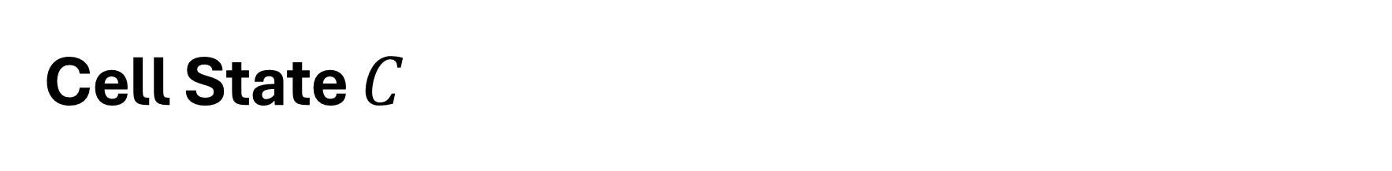
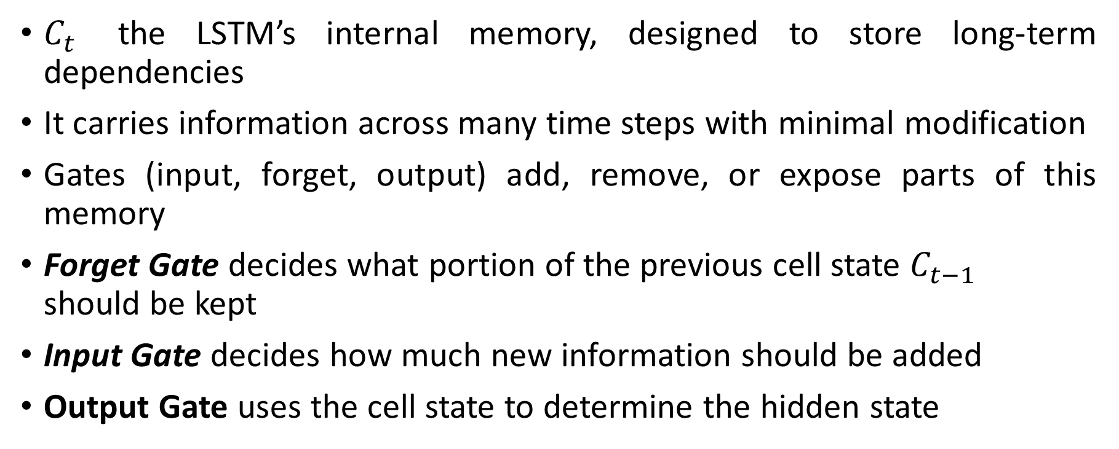
Cell State $C$
$C_{t}$ the LSTM’s internal memory, designed to store long-term dependencies
It carries information across many time steps with minimal modification
Gates (input, forget, output) add, remove, or expose parts of this memory
Forget Gate decides what portion of the previous cell state $C_{t−1}$ ​ should be kept
Input Gate decides how much new information should be added
Output Gate uses the cell state to determine the hidden state

Slide 21
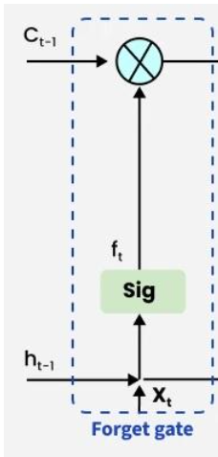
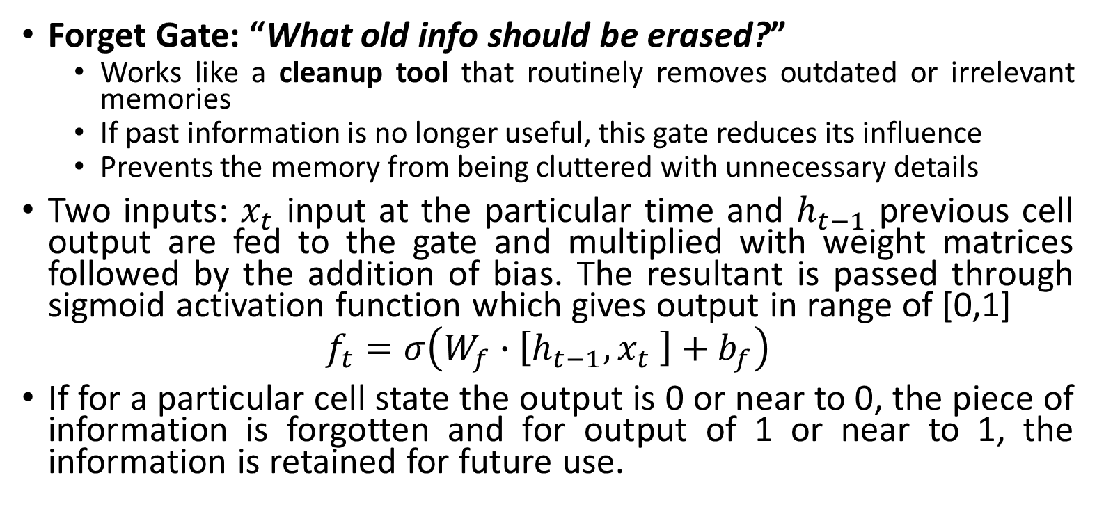
Forget Gate
Forget Gate: “What old info should be erased?”
Works like a cleanup tool that routinely removes outdated or irrelevant memories
If past information is no longer useful, this gate reduces its influence
Prevents the memory from being cluttered with unnecessary details
Two inputs: $x_{t}$ input at the particular time and $h_{t−1}$ previous cell output are fed to the gate and multiplied with weight matrices followed by the addition of bias. The resultant is passed through sigmoid activation function which gives output in range of [0,1]
$$f_{t}=σ\left(W_{f}∙\left[h_{t−1},x_{t} \right]+b_{f}\right)$$
If for a particular cell state the output is 0 or near to 0, the piece of information is forgotten and for output of 1 or near to 1, the information is retained for future use.

Slide 22
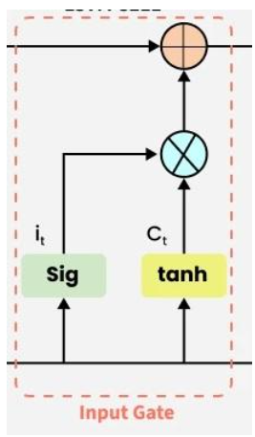
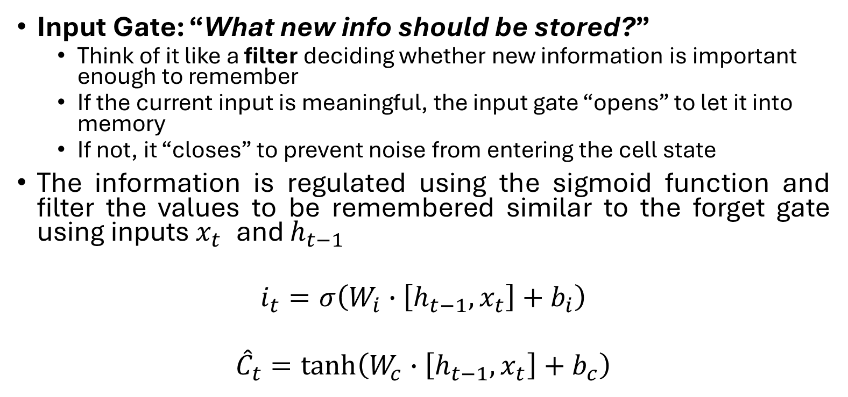
Input Gate
Input Gate: “What new info should be stored?”
Think of it like a filter deciding whether new information is important enough to remember
If the current input is meaningful, the input gate “opens” to let it into memory
If not, it “closes” to prevent noise from entering the cell state
The information is regulated using the sigmoid function and filter the values to be remembered similar to the forget gate using inputs $x_{t}$ and $h_{t−1}$
$$i_{t}=σ\left(W_{i}∙\left[h_{t−1},x_{t}\right]+b_{i}\right)$$
$${\hat{C}}_{t}=tanh\left(W_{c}∙\left[h_{t−1},x_{t}\right]+b_{c}\right)$$

Slide 23
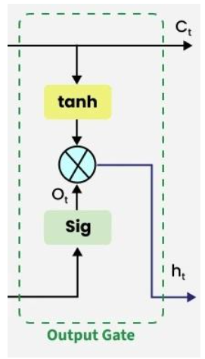
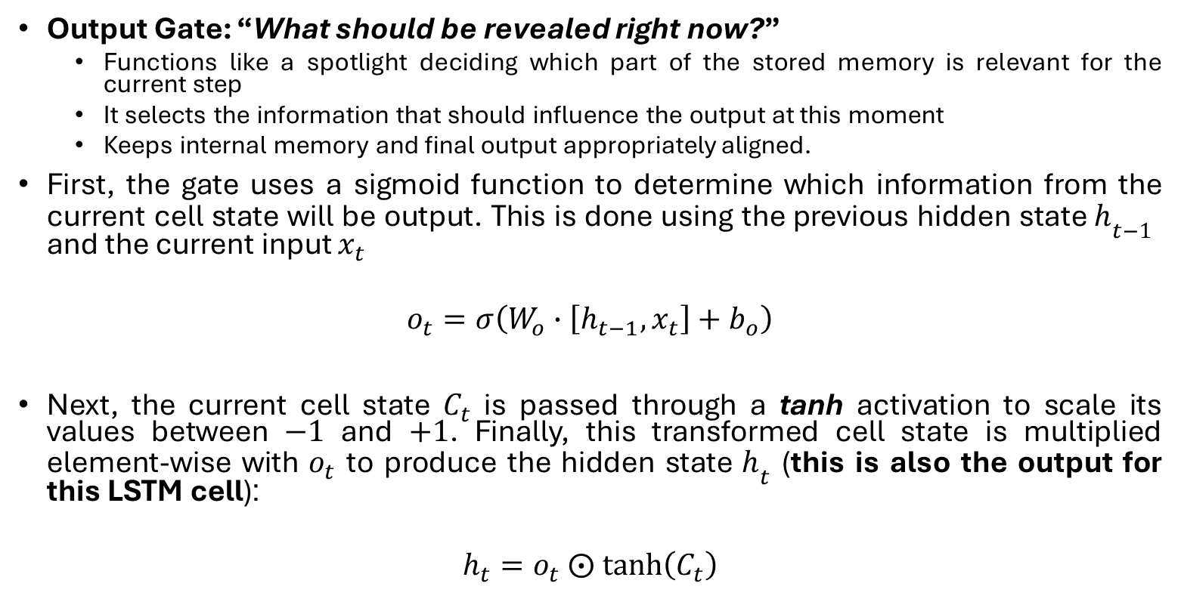
Output Gate
Output Gate: “What should be revealed right now?”
Functions like a spotlight deciding which part of the stored memory is relevant for the current step
It selects the information that should influence the output at this moment
Keeps internal memory and final output appropriately aligned.
First, the gate uses a sigmoid function to determine which information from the current cell state will be output. This is done using the previous hidden state $h_{t−1}$​ and the current input $x_{t}$
$$o_{t}=σ\left(W_{o}∙\left[h_{t−1},x_{t}\right]+b_{o}\right)$$
Next, the current cell state $C_{t}$​ is passed through a tanh activation to scale its values between $−1$ and $+1$. Finally, this transformed cell state is multiplied element-wise with $o_{t}$​ to produce the hidden state $h_{t}$ (this is also the output for this LSTM cell):
$$h_{t}=o_{t} ⨀ tanh\left(C_{t}\right)$$

Slide 24
Vanishing/Exploding Gradient Control in LSTM
Gating Mechanisms Control Information Flow
Forget Gate (Prevents exploding)
The forget gate decides how much of the previous memory to keep
If old information is not needed, the forget gate reduces its influence
This prevents the memory from accumulating too much useless information that would make gradients explode
Input Gate (Prevents vanishing)
The input gate controls how much new information is allowed into the memory
Important information is allowed in strongly; unimportant info is weakened
This keeps meaningful signals strong enough so they do not fade away (vanish)
Controlled Gradient Flow Through Gates
Gates use sigmoid and tanh to bound values.
Ensures gradients remain within stable ranges.

Slide 25
Vanilla RNN vs LSTM
RNNs remember the recent past; LSTMs remember what truly matters
RNNs forget quickly; LSTMs know what to keep and what to throw away
RNNs have short-term memory; LSTMs have short-term and long-term memory
RNNs react to the moment; LSTMs understand the story
RNNs recall yesterday; LSTMs recall the whole timeline
RNNs struggle with long sequences; LSTMs carry important information forward

